Slide 2
Dairy Cow feeding in Germany Points of Interest
Heiko Kornahrens
Productmanager

Slide 3
Dairy areas in Germany
in view for dairying Germany has about 4.2 million dairy cows
about 80% registered cows for breeding
Located in these main areas
north
east
south

Slide 4
Dairy areas in Germany
Different feeding and housing systems in Germany
„bigger“ farms (>70 cows) using free-stalls
Tie-stall barns in smaller herds (south)

Slide 5
Dairy areas in Germany
Most of the „bigger“ farms (>150 cows) using the Total-Mixed-Ration (TMR) as a feeding system.
using TMR as a feeding strategie
Robot milking in 40% of all new milking Parlors

Slide 6
Dairy areas in Germany
northern part of Germany:
Nearly all farms are „Familien-Betriebe“ - family owned and operated farms
Average size 82 cows per farm
(1 – 2300cows)
Mainly using Holstein-Frisian Genetic
Average milk yield – 8.900 kg

Slide 7
Dairy area´s in Germany
eastern part of Germany:
mostly owned and driven by co-op´s or other forms (GbR, GmbH, …)
Average size 286 cows per farm
Mainly using Holstein-Frisian Genetic
Average milk yield – 9.400 kg

Slide 8
Dairy area´s in Germany
southern part of Germany:
Nearly all farms are „Familien-Betriebe“ - family owned and operated farms
Average size nearly 38 cows per farm
Mainly using Simmental Genetic
Average milk yield – 6.800 kg

Slide 9
Dairy cows
Dry matter intake – most important issue
Water consumption – sufficient and clean
Cow Comfort – a cow need to spend:
1/3 of life eating
1/3 of life resting
1/3 of life chewing cud

Slide 10
Dairy cows
Take care that all farm factors that affect the milk production are in a perfect way. (feed bunk, healthy feet, facilities, barn construction and so on).
Don´t judge it by human standard,
judge it by a cow standard

Slide 11
Requirement of nutrients
Remember: Not only nutrients
In all phases of lactation (life) there are special needs for the cows.
During close-up and fresh cow the biggest impact on cows is cow-comfort, take care for a dry and clean enviroment with fresh air and fresh water
Always keep an eye on these cows

Slide 12
Requirement of nutrients
Try to see the requirements in the different stages of life or better during Lactation and Gestation
Fresh 0 - 30
Early 31 - 120
Mid 120 - 250
Late 250 -
Dry (Far off) 60 – 21 p.p.
Close (Close up) 21 – p.p.
Lactation
Dry period

Slide 13
Requirement of nutrients
Try to see the requirements in the different stages of life or better during Lactation and Gestation
Fresh 0 - 30
Early 31 - 120
Mid 120 - 250
Late 250 -
Dry (Far off) 60 – 21 p.p.
Close (Close up) 21 – p.p.
Lactation
Dry period

Slide 14
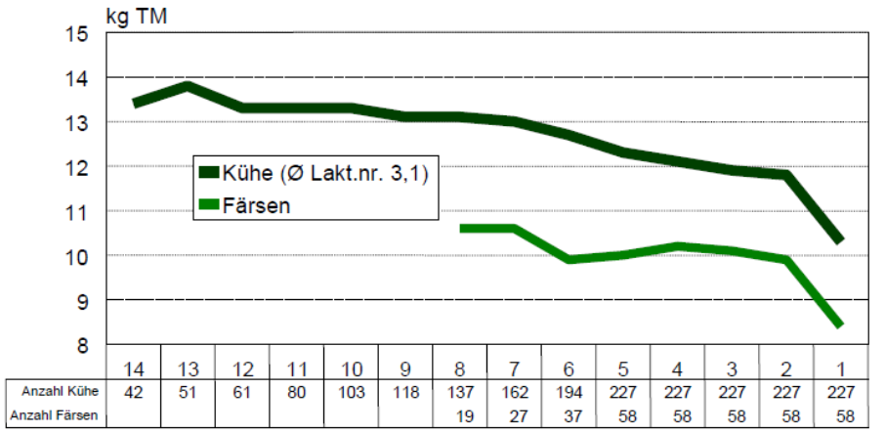
Feed Intake (DMI) in Transition period
DMI kg
Cows n
heifers n

Slide 15
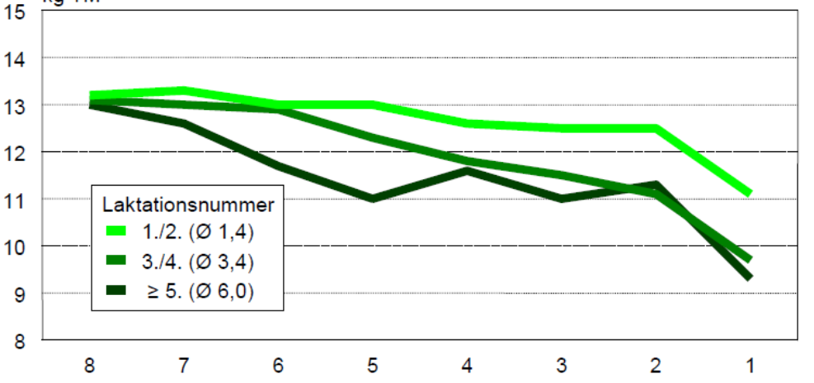
Feed Intake (DMI) in Transition period
DMI kg
Days before calving

Slide 16
Relationship between Dry Matter Intake (DMI) befor calving and features in early Lactation
Feed intake in the last kg DMI body body DMI per 100
week bevor calving per day weight kg fat mm kg body weight
20% „best eater“ 15,9 740 20,8 2,1
Average (270 cows) 11,9 714 20,5 1,7
20% „bad eater“ 7,8 716 20,4 1,1

Slide 17
Relationship between Dry Matter Intake (DMI) befor calving and features in early Lactation
Feed intake in the last kg DMI in the first 100 days of lactation
week bevor calving per day milk kg fat % protein % cullings
20% „best eater“ 15,9 48,2 4,06 3,18 0
Average (270 cows) 11,9 45,6 4,05 3,15 10%
20% „bad eater“ 7,8 42,0 4,06 3,15 23%

Slide 18
Relationship between Dry Matter Intake (DMI) befor calving and features in early Lactation
Feed intake in the last Fertility / Reproduction
week bevor calving Insemination Pregnant days open Insemination Index
20% „best eater“ 100% 92% 142 2,4
Average (270 cows) 92% 83% 136 2,5
20% „bad eater“ 79% 75% 147 2,9

Slide 19
Dry matter intake (DMI)
Forage Quality – most important Farm Factor:
Energy concentration, or better:
Quality and quantity of fibre, if you don´t meet the standards in forage production, you may have a milk production from concentrates, but young dying cows.

Slide 20
Dry matter intake (DMI)
Goals in forage Quality:
DM Content fits the forage material, for exampel:
Corn silage between 30 – 35 % DM
Gras silage between 35 - 45 % DM
no Silage without inoculants
maximum packing
Cover correct with plastics
heat and mold processes – losing energy and feed intake

Slide 21
Dry matter intake (DMI)
DMI is based on body weight and especally on the level of milk production.
For close-up and fresh cows avoid fat levels over 5%, that will immediately reduce feed intake
Total ration moisture from fermented feeds under 55%, otherwise feed intake declines 3-5 % (not Pasture)
Ensure that the cows are removed from feed for max. 4 hours per day (milking area, holding area)

Slide 22
Dry matter intake (DMI)
Forages min. 6,0 MJ NEL
ADF should range from 19 – 21 percent
NDF should range from 28 – 33 percent
NFC should range from 33 – 38 percent
Crude Protein not less than 16,0 percent
nXP not less than 15,5 percent

Slide 23
Dry matter intake (DMI)
Prevent cows from seperating and selecting preferred feed ingredients
2 up to 5 percent weight back of uneaten feed
Total ration dry matter from 40 – 45 percent
Fat limit for high producing cows 6 percent
Dry cows not over BCS 4
Keep feed in front of cows

Slide 24
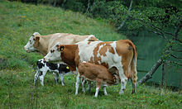
Requirements and recommodations
Calculation 1.0

Slide 25
Requirements and recommodations
Calculation 2.0
with energy and crude Protein (XP)
up to 8.000 kg milk ?
higher costs ?
rumen health (structure) ?

Slide 26
Requirements and recommodations
Calculation 3.0
ADF / NDF / NFC for structure and fiber
undegradeble starch

Slide 27
Requirements and recommodations
Calculation 3.1
ADF / NDF / NFC for structure and fiber
undegradeble starch
Protein with nXP
Protein for Rumen bugs and small intestine

Slide 28
Requirements and recommodations
coming soon
Calculation 4.0
fermentable Protein and Carbohydrates
Amino Acids, delivering to small intestine
glucogenic nutrients

Slide 29
Requirements and recommodations
Calculation 3.1 nXP
calculates the efficiency in rumen bacteria and microbes
microbial Protein delivers 70% of the Protein
UnDegradeble Protein in the Rumen – direct to small intestine

Slide 30
nXP, RNB und UDP
100%
75%
WISAN Raps 38:62
50%
compound feed 60:40
25%
ideal line 70:30
silage 80:20
rumen
small intestine

Slide 31
Requirements and recommodations
calculate Protein after nXP means:
higher milk yields
less protein in the ration
less feed costs
healthier cows
(Environment)

Slide 32
Protein quality
Soybean meal / Rapeseed meal
vs.
Wisan rapeseed

Slide 33
Rape seed meal

Slide 34
Soybean meal

Slide 35
„protected rapeseed meal“ (Wisan)

